Slide 1
4.2: Right Triangle Trigonometry
MATH 1550 - Precalculus

Slide 2

Right Triangles
A triangle that has one angle measuring ${90}^{∘}$.
(Pythagorean Theorem) For any right triangle,
$$a^{2}+b^{2}=c^{2}$$

Slide 3
Special Right Triangles

Slide 4
Find the missing side lengths of the given right triangle:

Slide 5

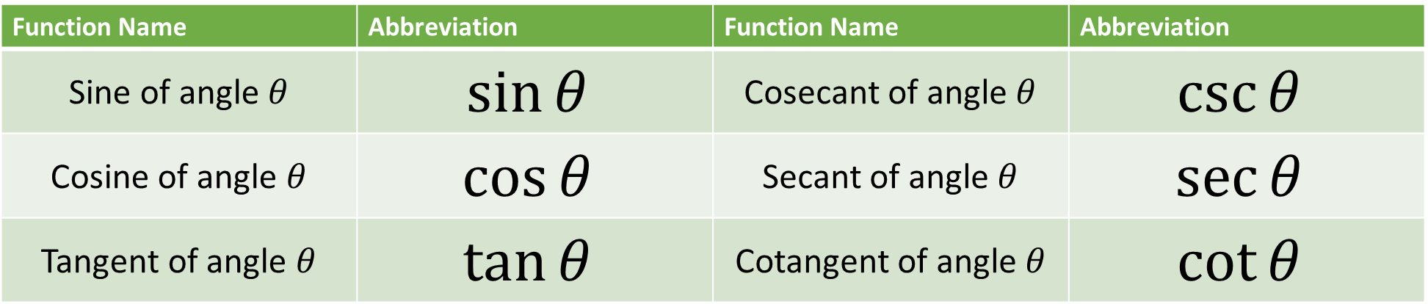
Trigonometric Functions
Function Name | Abbreviation | Function Name | Abbreviation
Sine of angle $θ$ | $$sin⁡θ$$ | Cosecant of angle $θ$ | $$csc⁡θ$$
Cosine of angle $θ$ | $$cos⁡θ$$ | Secant of angle $θ$ | $$sec⁡θ$$
Tangent of angle $θ$ | $$tan⁡θ$$ | Cotangent of angle $θ$ | $$cot⁡θ$$
$$θ$$

Slide 6
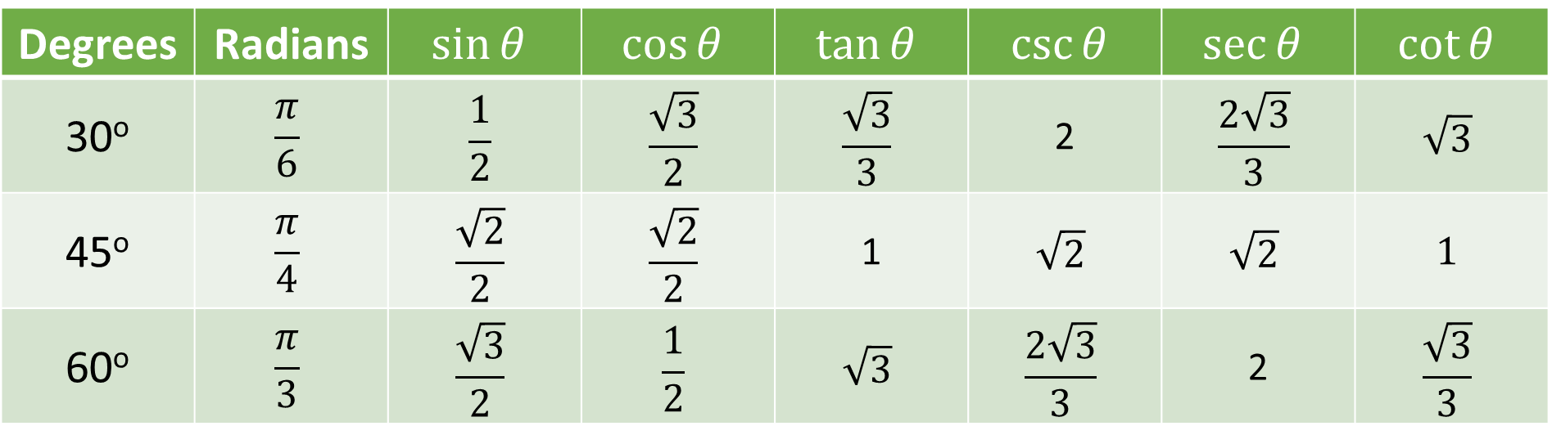
Trigonometric Function Values for Special Angles
Degrees | Radians | $$sin⁡θ$$ | $$cos⁡θ$$ | $$tan⁡θ$$ | $$csc⁡θ$$ | $$sec⁡θ$$ | $$cot⁡θ$$
30º | $$\frac{π}{6}$$ | $$\frac{1}{2}$$ | $$\frac{\sqrt{3}}{2}$$ | $$\frac{\sqrt{3}}{3}$$ | 2 | $$\frac{2\sqrt{3}}{3}$$ | $$\sqrt{3}$$
45º | $$\frac{π}{4}$$ | $$\frac{\sqrt{2}}{2}$$ | $$\frac{\sqrt{2}}{2}$$ | 1 | $$\sqrt{2}$$ | $$\sqrt{2}$$ | $$1$$
60º | $$\frac{π}{3}$$ | $$\frac{\sqrt{3}}{2}$$ | $$\frac{1}{2}$$ | $$\sqrt{3}$$ | $$\frac{2\sqrt{3}}{3}$$ | 2 | $$\frac{\sqrt{3}}{3}$$

Slide 7
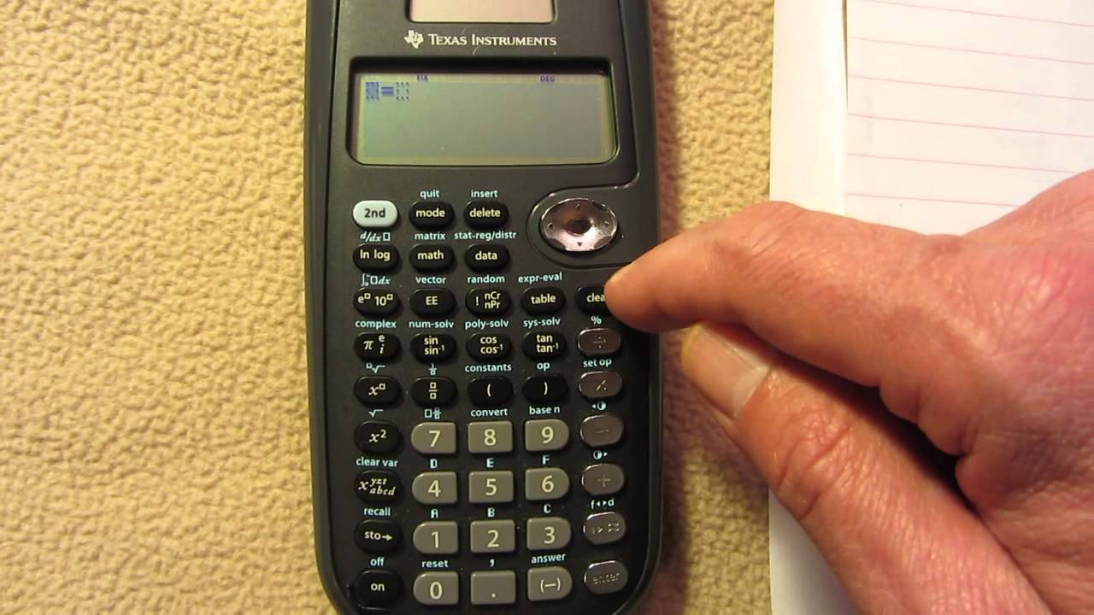
Calculating Trig Values on a Calculator

